Slide 1
Architectural Test SIG Call –Minutes
Thur, 28Jul2022 8am Pacific → Daylight ← Time
See slide 7 for agenda

Slide 2
Antitrust Policy Notice
RISC-V International meetings involve participation by industry competitors, and it is the intention of RISC-V International to conduct all its activities in accordance with applicable antitrust and competition laws. It is therefore extremely important that attendees adhere to meeting agendas, and be aware of, and not participate in, any activities that are prohibited under applicable US state, federal or foreign antitrust and competition laws.
Examples of types of actions that are prohibited at RISC-V International meetings and in connection with RISC-V International activities are described in the RISC-V International Regulations Article 7 available here: https://riscv.org/regulations/
If you have questions about these matters, please contact your company counsel.

Slide 3
Collaborative & Welcoming Community
RISC-V is a free and open ISA enabling a new era of processor innovation through open standard collaboration. Born in academia and research, RISC-V ISA delivers a new level of free, extensible software and hardware freedom on architecture, paving the way for the next 50 years of computing design and innovation.
We are a transparent, collaborative community where all are welcomed, and all members are encouraged to participate. We are a continuous improvement organization. If you see something that can be improved, please tell us. help@riscv.org
We as members, contributors, and leaders pledge to make participation in our community a harassment-free experience for everyone.
https://riscv.org/community/community-code-of-conduct/

Slide 4
Only RISC-V Members May Attend
RISC-V attendance
Non-members are asked to please leave.
Members share IP protection by virtue of their common membership agreement. Non-members being present jeopardizes that protection
It is easy to become a member. Check out riscv.org/membership
If you need work done between non-members or or other orgs and RISC-V, please use a joint working group (JWG).
used to allow non-members in SIGs but the SIGs purpose has changed.
Please put your name and company (in parens after your name) as your zoom name. If you are an individual member just use the word “individual” instead of company name.
Non-member guests may present to the group but should only stay for the presentation. Guests should leave for any follow on discussions.

Slide 5
SIG Charter
The Architectural Compatibility Test SIG is an umbrella group that will provide guidance, strategy and oversight for the development of tests used to help find incompatibilities with the RISC-V Architecture as a step in the Architectural Compatibility self-certification process
The group will:
Guide Development of:
Architectural tests for RISC-V implementations covering ratified and in-flight specifications for
Architectural versions, standard extensions, and implementation options.
Tools and infrastructure to help identify architectural incompatibilities in implementations
Work with TSC and Chairs for resources to get the above work done.
Mentor or arrange for mentoring for the resources to get the above work done

Slide 6
Adminstrative Pointers
Chair – Allen Baum allen.baum@esperantotech.com Co-chair – Neel Gala
SIG Email sig-arch-test@lists.riscv.org. Notetakers: please send emails to allen.baum@esperantotech.com
Meetings -Bi-monthly at 8am Pacific time on 2^{nd/}4th Thursdays.
Documents, calendar, roster, etc. in
https://sites.google.com/a/riscv.org/risc-v-staff/home/tech-groups-cal
https://drive.google.com/drive/folders/1DemKMAD3D0Ka1MeESRoVCJipSrwiUlEs lifecycle in ”policies/supporting docs” folder, gaps in “planning” folder, arch-test specific in “information->content->arch-test”)
Git repositories ←docs riscv → tools
https://github.com/ riscv-non-isa /riscv-arch-test/tree/master/doc tests https://github.com/riscv-non-isa/riscv-arch-test
https://github.com/riscv-software-src/riscof/tree/master/docs riscof https://github.com/riscv-software-src /riscof
https://github.com/riscv-software-src/riscv-ctg/tree/master/docs Test Gen. https://github.com/riscv-software-src /riscv-ctg
https://github.com/riscv-software-src/riscv-isac/tree/master/docs YAML, WARL config https://github.com/riscv-software-src /riscv-config/
https://github.com/riscv/sail-riscv/tree/master/doc Sail formal model https://github.com/riscv/sail-riscv/
https://github.com/riscv-admin/architecture-test minutes, charter
JIRA: https://jira.riscv.org/projects/CSC/issues/CSC-1?filter=allopenissues
Sail annotated ISA spec: in https://github.com/rems-project/riscv-isa-manual/blob/sail/
README.SAIL ←how to annotate annotated unpriv spec→ release/riscv-spec-sail-draft.pdf
release/riscv-spec-sail-draft.pdf ← annotated source annotated priv spec→ release/riscv-privileged-sail-draft.pdf
https://us02web.zoom.us/rec/share/-XIYazzhIBbQoiZdarCfebdjxjDWiVhf-LxnuVrliN4Bc30yf17ztKkKDU4Og54b.fArPPqnuR-NiXpQU
Tutorial Passcode: tHAR#5$V

Slide 7
Meeting Agenda
0. Looking for more admins, maintainers for riscv-arch-test git repo !!
Updates, Status, Progress:
FP status
Other status
Next steps and Ongoing maintenance
Running Riscof in an IT constrained environment
Making Jenkins tests be more C/I friendly
Supporting Zicntr and Zihpm testing
Supporting Trace/Debug testing,
Issue/PR resolution status
Priv mode testing – methodology and previous work
How should we implement explicit mode changes inside a test
Discussion: other steps for Migration to Framework v.3.0 (riscof). (blocking items):
Reference signature docker image, local podman/docker plugins, remote podman YAML
Refsig-as-a-Service (RSaaS) implementation
Asynch Event Generator TG – next steps (under auspices of Simulator SIG) need for interrupts, LR/SC, WRS.xxx, Zicntr)
Discussion: should - should machine generated SAIL to be allowed for CSR read/write legalization?
Dynamic Test Generation
Related: how should we deal with 1GB test directories (FP
Revisit Config YAML GUI interface
Future Agenda items
Maintenance updates to V2 to enable future tests
Convert assertions to be out-of-line
add assertion macros for FP, DP, Vreg to arch_test.h and test_format spec
add trap handlers for S, VS modes to handle VM
Compile a definitive list of architectural options
Tests for non-deterministic result (see attached discussion in email)
Provide a reference RTL test fixture (as opposed to SW functional model). See. JIRA CSC-6
Define hooks for concurrency tests
Specific Arch-Test Policy/Process Gaps:
Identify Tool providers, e.g. coverage model, test generation for new features/extensions
Flesh out test development order & identify resources (e.g. Priv,FDD or F,Priv,D…, JIRA CSC-3,5

Slide 8
riscof_install_example_DUT
Why the need for this repo? (https://github.com/InspireSemi/riscof_install_example_DUT)
Dependencies needed to install under are split between those that need to be installed using root privileges and those that are installed into a users local home directory, under .local.
Users of the arch test suite did not have the experience in installing packages, building libraries, etc. A way to help them to get up and running was needed.
Running under RHEL 8 (our development environment) had it’s own unique challenges. For example Z3 a dependency for sail (I think) was not available as a package under RHEL. So this hd to be built from scratch and installed to a users local dir. Another example was opam, RHEL did not have this available. Since compiling this was not an option, the binary release was chosen and is copied to ~./local/bin/ (version being used is opam-2.1.0-x86_64-linux).
Ubuntu vs RHEL why two OSes?
While Ubuntu is by far the choice for most software developers these days. Anyone doing chip level development is limited to what is supported by the major tool vendors, Synopsis, Cadence, Mentor, etc..
See : https://www.cadence.com/en_US/home/support/computing-platform-support.html

Slide 9
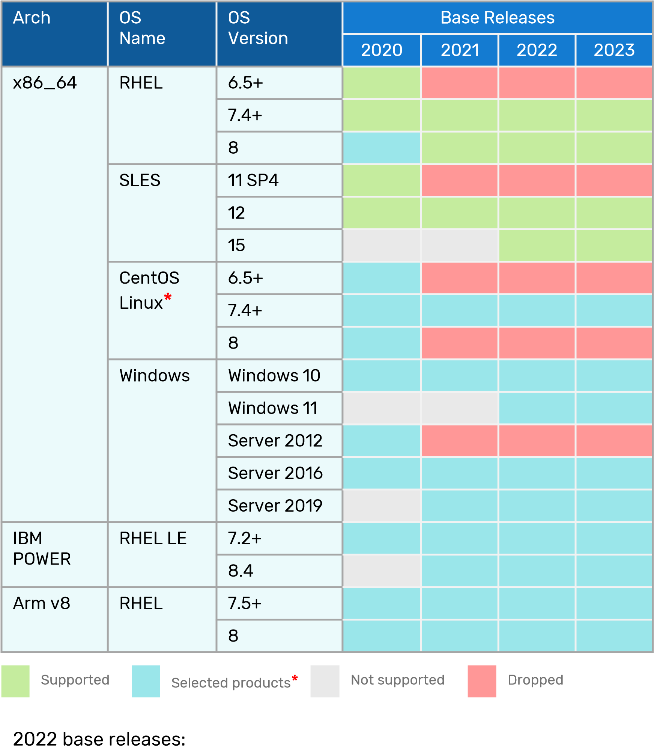
2020-2023 Cadence Compute Platform Roadmap
x86_64
Add SLES 15
Add Windows 11 2023 base releases:
Same as 2022
* Cadence supports CentOS Linux, but disclaims any liability for any errors or bugs in CentOS Linux
* Consult Cadence Downloads Portal for products on specific OS version

Slide 10
Discussion
Status
RV32E tests – some tests in place, EABI has proposed Sail Configuration is in progress (e.g. being able to specify the reset vector) Bitmanip PR needs review –
Marc Karasov’s Github repo for simplifying running Riscof in a constrained IT environment
https://github.com/InspireSemi/riscof_install_example_DUT talk. (see next 2 slides)
Running Riscof has many dependencies including root priv install dependencies that need to install, home ./local/bin, lib, sbin, etc
verif /validation engineers don’t have experience installing/building, etc & clone/download, building, installing
RedHat8 – e.g. Z3 is not available as a package under RedHat, z3prover/z3.git Needs to be built from scratch installed in your home directory, easier e.g. OPAM (package mgr for Ocaml ) not available, source not available - so we have to grab binary
Chip developers don’t use Ubuntu - all major tool vendors use Windows/RHEL/SLES/Centos,RockyLinux
Repo has: an example DUT: YAML, install scripts for RHEL/Ubuntu It: Clones Z3, builds in home ~/.local, copies OPAM Installs sail, arch-test, riscof Set paths to tools, Sail csim has Shell commands to run it all
Inspire model has enough memory to run all tests
This repo and model at same directory level, There is a script to run elf->binary, (freedom bin2hex->hex64 file) for loading code It converts the test to a 64bit binary, backdoor loads it into DUT memory, using $readmemh tool Rtl is in a directory with a binary of the DUT
What is needed to be customized: YAML Script to run in bin directory Set path to saildir? Run script needs to point to the toolchain Plugin.py

Slide 11
Decisions & Action Items
Decisions ()
Verify that issues 4,22,40, 146..149, 189 are all successfully dealt with by riscof framework
Outstanding Action Items
Get test failure data for misaligned tests <inspire>
Add test failure debug hints in readme <inspire, incore, axiomise>
find a different place to put coverage reports <Chair - in progress>
Look for and setup ref-signature-as a service site using docker image of Sail and tests < Chair > drilling down to details
Update std trap handler for explicit mode & MMU changes, <needs more work and testing>
Develop plugins for podman as well as remote container < HC? >
Propose new wording for Bare mode encoding restrictions <chair>
Set up a TG to define Async Event Generator specs (test interface, Model interface, generator SW that can interface to RTL and simulators, sample shims for Spike and Sail <chair>
File binutils update to allow use of rounding mode <incore>
(issue #233) Document RVTEST_ISA changes required, add to test format spec <Incore>
(issue #203) Add fence test with all set bits) <Incore>
(issue#119) Add rm field fence.i walking ones test
(issue #190) Document options for ( 16B sig size) <chair>
Delete target directory from main repo branch <Incore>
Rewrite test-Format_spec, splitting into test developer guidelines and model requirements

Slide 12
BACKUP

Slide 13
Issue #233
The latest version of the toolchain expects _Zicsr to be present in the march argument for tests which execute csr* instructions. The current tests do not include this extension in the argument to the RVTEST_ISA macro. Any test which needs to include the trap handler (via the rvtest_mtrap_routine) conditionally or unconditionally will have to be updated according to the definition here.
Another solution would be to have a policy to include zicsr in the march string always(if it is present in the isa of input yaml). This would also allow the boot code to contain csr instructions. That way the tests may or may not have the Zicsr explicitly set in the RVTEST_ISA string.
The check statements in the RVTEST_CASE macro drive the conditions for choosing a test. The RVTEST_ISA macro is just a indication of the string which should be passed to the march argument of gcc while compiling. Adding Zicsr will not affect the test filtering in any way.

Slide 14
Issue #233
The test-format-spec says that the signature should always begin at a 16-byte boundary
"it should also end at a 16-byte boundary. Due to the above requirements, the spike model_test.h constraints the alignment of the the RVMODEL_DATA_BEGIN and RVMODEL_DATA_END to 16-byte boundaries. This means the RVMODEL_DATA_END is at an offset of n*16 bytes from RVMODEL_DATA_BEGIN.
But actual test only have a 4B boundary constraint, so there can be 4,8, or nytes in the signature which are not initialized by the test and can be any value the model decides (which in GCC is 0x0). Hence, if you look at the last entries of the reference signature of a reference_output they are going to 0's instead of 0xdeadbeef
Now, since the extra padded values are controlled by the DUT, they can be anything.
Possible solutions:
Update the spec to mandate that the values being alignment padded must be 0xdeadbeef. It shouldn't be 0x0 since the spec mentions here that the signature must be loaded with 0xdeadbeef This will require updating the references and all ported targets. The targets could achieve the above by simply using .align 4,0xdeadbeef instead. No changes to tests.
Change the spec to mandate that the signature should end at a 4-byte boundary. This will require all targets to remove any .align 4 from their macros, since by default all test signatures end at a 4-byte boundary. This will require references to be updated. No change to tests.
Explicitly pad the tests to align at 16-byte boundaries. This will require updating the tests and the corresponding references. No changes to the model side (or at least that is what I hope).

Slide 15
A list of CSRs and a list of state each depend on to specify a format
containing a list of dependency values and the field format they describe
containing a list of each field in that format and its mapping function
containing a list of legal value/ranges for that field
LegalizeCSR(int12 CSR_num, Wr_data, mode)
CSR_STRUCT
CSR_STRUCT
CSR_STRUCT
Could be empty!
unchg, wr_val
near_up, near_dn,
nxt_up, nxt_dn,
large small,
extend, wpri, imm_val
List
CSR_STRUCT
Bitfld64
reset
bitfield
int12
CSR_NUM
CSR_FMT
CSR_FMT
FLD_FMT
List
CSR_FMT
CSR_FMT
FLD_FMT
List
DEP_LIST
FLD_FMT
List
DEP_ELE
Bitfld6
fld_msb
This defines which state are dependencies
List
FLD_FMT
Bitfld6
fld_lsb
union
This defines state values corresponding to a CSR format.
List
FLD_RNG
FLD_ RNG
FLD_ RNG
CSR, Xreg, Freg, Vreg
LGL_DEPS
FLD_ RNG
FLD_ RNG
LGL_DEPS
LGL_DEPS
enum
map_func
FLD_RNG
FLD_ RNG
DEP_ELE
List
FLD_RNG
Bitfld64 fld_msk
Int64?
rng_hi
DEP_ELE
Lists must be same leng &
In same order
bitfield
imm_val
DEP_ELE
FLD_RNG
There can be multiple sets of dependency values for each format
Bitfld64 fld_val
Int64?
rng_lo
int12
REG_NUM
FLD_RNG
enum
dep_type
FLD_RNG
Int64
rng_hi
Each list member describes a CSR field position, points to the list of legal value ranges for that field, and the mapping function for anything illegal.
Bitfld6
fld_hi
Used to
dependency values
Int64
rng_lo
Notes:
For RV32, change bitfield64 to bitfield32
Int64 to Int32
int6 to int5
TBD: how to deal with shadow fields? Can shadow fields have dependencies? Need to point to shadowed field via
int12 csrnum, int6 fld_hi, int6 fld_lo.
Does WLRL need special handling?
Fld_hi==fld_lo
is a 1 bit field
fetch
check
Bitfld6
fld_lo
When all DEP_ELEs are within FLD_RNGs, the FLD_FMT list describes the CSR field format
For each field in that format, search the FLD_COND list for a range that includes the wr_val, and apply the mapping function to update that field value)
Optional, unimplemented CSRs are encoded as bitmask with zero mask, zero value
If DEP_LIST is empty, then DEP_VAL must be empty
If FLD_FMT is empty, then the entire reg is RW (or RdOnly depending on CSR#) with no WARL fields
RdOnly is handled as rng_hi<rng_lo with map_func = unchg
native
List()
struct
union

Slide 16
Riscof Cut-over May 1, 2022
Steps for cutover:
1.Talk to openHW Mike Thompson, Rick O’Conner loop them in, remove test disclaimer? (scheduled and done)
2.local Docker container + CI to keep it up to date Separate from RefSig-as-a-Svc because adding riscof into container adds a CI dependency that’s avoidable 3. ensure clear documentation about the 2 ways to run Local container build from scratch
Gap: readthedocs Ensure docs are idiot proof and hand all scenarios ex. riscof_quickstart: has “build from scratch; we need to, add link to install docker (that should be to simply change one flag (in the quickstart ) see https://gitlab.com/incoresemi/riscof-plugins/-/tree/master/sail_cSim#using-docker-with-this-plugin
Gap: we need more people to try this out (see mass mailing below)
4. Cutover: a. make sure riscof-dev branch is up-to date with latest trap handler & updated macros, updated README*** b. add warning to README in main branch and riscov-dev branch that cutover will happen Mar 31 c. Mass mailing: new framework, riscof, docs here, need feedback, header, isa-string fixes, cutover date d. Swap master** arch-test branch with riscof-dev branch
5.Later: →get podman plugin, add link to install podman (singularity?) → remedial tests: RV32D,RV64F,A-extension, Priv1.11,-->1.12 → RefSig-as-a-Service container + CI to keep it up to date + documentation in #3 Q: What is the method for access control of the system? (i.e. policy&procedures, like token based system to track job submission , access control). Q: How many concurrent users should be allowed access? (i.e. control system load & prevent failing jobs due to a lack of resources or taking up a lot of time. → asynch event generator for interrupt and ** I think we are supposed to rename ”master” to something else, e.g. “main”. Also: is it time to remove stale branches? *** Explain that using this now requires YAML+model_test.h+plugins. linking to the testbench – but not just the core, the whole SOC? Can we provide default YAML? Do existing model_test.h.s need to change? Remove or modify disclaimers because we have YAML configuration (although primarily misalign support right now) Note that CTG macros (e.g. SIGUPD*) don’t match rvtests.h macros, and there are many new macros
Local container: 1.8GB (toolchain: 1.5GB) (python,asm) (csim,, ocaml, spike: .3GB)
RefSig-as-a-Service: 1.8GB+ (toolchain: 1.5GB) ) (python,asm) (csim,, ocaml: .3GB) + (riscof, plugin)

Slide 17
Future Topics

Slide 18
Draft Internal Test Guidelines
Required Pre-Defined Macros – Macros that every test must include
RVTEST_CODE_BEGIN This saves state and conditionally initializes the trap handler and initializes gprs
RVTEST_CODE_END This conditionally saves the post-test GPR values, transitions to Mmode,
conditionally restores pre-test state and causes branches to test halt, then
conditionally installs the trap handler
RVTEST_DATA_BEGIN This initializes the a pointer to that trap signature area of the test signature,
and reserves space for a pointer to the save area used to save and restore state
modified by the trap handler .
RVTEST_DATA_END Contains the current trap signature pointer (if traps are enabled) ***FIXME-1/mode
This macro marks the end of the test input data section with label rvtest_data_end
RVTEST_CASE(CaseName, CondStr)
execute this case only if condition in cond_str are met
CaseName is arbitrary string
CondStr is evaluated to determine if the test-case is enabled and sets name variable
CondStr can also define compile time macros required for the test-case to be enabled.
The test-case must be delimited with an #ifdef CaseName/#endif pair
The format of CondStr can be found in https://riscof.readthedocs.io/en/latest/cond_spec.html#cond-spec
RVTEST_GOTO_MMODE This is used whenever a test halts to put it in Mode so it can restore all state*
RVTEST_GOTO_LOWER_MODE(mode) MRET to lower priv mode (requires identity mapped MMU if transitioning to a mode with different MMU state)
Helper Macros These are instantiated by the required macros
RVTEST_INIT_GPRS
RVTEST_TRAP_PROLOG sets up trap environment, depends on rvtest_strap_routine & rvtest_vtrap_routine
RVTEST_TRAP_HANDLER saves trap status in sig & rtn; depends on rvtest_strap_routine & rvtest_vtrap_routine
RVTEST_TRAP_EPILOG restores trap environment; depends on rvtest_strap_routine & rvtest_vtrap_routine
RVTEST_TRAP_SAVEAREA set up save area for trap; depends on rvtest_strap_routine & rvtest_vtrap_routine
RVTEST_SAVE_GPRS(tmpreg, saveaddr) saves all regs except tmpreg to saveaddr at test end if gpr_save defined
Required Pre-Defined Variables architecturally defined
RVTEST_DATA_REL_TVAL_MSK (bit-reversed mask of which exceptions store data addrs in xtval. Defaults to left aligned 0x0F05 (causes 4..7, 13, 15) **update for H-ext
RVTEST_DATA_REL_TVAL_MSK (bit-reversed mask of which exceptions store code addrs in xtval.
Defaults to left aligned 0xD008 (causes 0,1,3,12) **update for H-ext
NUM_SPECD_INTCAUSES (defaults to 16) ***fix for H-ext
NUM_SPECD_EXCPTCAUSES (defaults to 16) ***fix for H-ext
Required predefined labels:
rvtest_entry_point The test must define this label to indicate the location to be used by the linker as the
entry point in the test. Generally, this would be before the RVMODEL_BOOT macro and
should belong to the text.init section.
mtrap_sigptr The test must define this between rvmodel_sig_begin and rvmodel_sig_end to mark where normal signatures end and trap signatures begin.
***FIXME: need copies per mode, e.g. strap_sigptr, vtrap_sigptr
rvtrap_sigptr. The test must define this to delimit where the trap signature starts
gpr_save The test must define gpr_save after rvmodel_sig_end to mark where
registers get saved if rvtest_gpr_save is defined
rvtest_trapsig defines where in the signature area trap signature is stored
rvtest_init
rvtest_code_begin used to relocate code-relative trap status
rvtest_data_[begin/end] used to relocate data-relative trap status
rvtest_sig_[begin/end] used to define the signature region
rvtest_[m,s,v]trap_routine used to conditionally instantiate helper macros, depending modes a test will trap into
Optional, Pre-defined Macros These are helper macros that make test generation easier. The include a set that gives a standard way of storing
signatures from the various registers, keeping track of the signature offset, offset overflow, and offset alignment
.
RVTEST_SIGBASE(BaseReg,Val) defines the base register used to update signature values
Register BaseReg is loaded with value Val, hidden_offset is initialized to zero
RVTEST_BASEUPD(BaseReg[oldBase[,newOff]]) [moves &] updates BaseReg past stored signature.
Hidden_offset is re-initialized to 0 afterwards
RVTEST_VALBASEUPD(BaseReg [, Offset])
RVTEST_SIGUPD( BaseReg, SigReg [, Offset])
RVTEST_SIGUPD_F( BaseReg, SigReg, FlagReg [, Offset])
RVTEST_SIGUPD_FID(BaseReg, SigReg, FlagReg [, Offset])
Updates the base reg by hidden or explicit offset. Flagreg is the gpr where fstatus CSR is loaded
**why is a flag register needed? The macro could copy fstatus into SigReg after storing it.
TBD Optional, Test-defined Variables
RVTEST_VA2PA perform a page table walk
RVTEST_GVA2PA perform a 2 level page table walk

Slide 19
Draft: External Arch-Test Spec
Required, Model-defined Macros
These macros are be defined by the owner of the test target in the file model_test.h. These macros are required to define the signature regions and also the logic required to halt/exit the test.
RVMODEL_HALT
This macros must define the test-target halt mechanism. This macro is called when the test is to be terminated either due to completion or due to unsupported behavior. This macro could also include routines to dump the signature region to a file on the host system which can be used for comparison.
Optional labels
Optional Model Defined variables (**FIXME – need to complete)
RVMODEL_ADDR_SZ_ (default to the largest possible size if not defined)
RVMODEL_PHYS_ADDR_SZ (default to 57 for RV64, 34 for RV32S, 32 for RV32)
RVMODEL_CACHE_BLK_SZ (default to 64)
NUM_SPECED_INTCAUSES (default to 16) **FIXME for HEXT
NUM_SPECED_EXCPTCAUSES (default to 16) ) **FIXME for HEXT
FENCEI (default to fence.i)
RVTEST_DATA_REL_TVAL_MSK (bit-reversed mask of which exceptions store data addrs in xtval. Defaults to left aligned 0x0F05 (causes 4..7, 13, 15) **update for H-ext
RVTEST_DATA_REL_TVAL_MSK (bit-reversed mask of which exceptions store code addrs in xtval.
Defaults to left aligned 0xD008 (causes 0,1,3,12) **update for H-ext
Model requirements:
Each xTVEC is either arbitrarily writable or initialized to a memory address that has RWX permissions and at least 580 bytes in size (specifically: (XLEN + 3* NUM_SPECD_INTCAUSES + 17) * 4). Altogether (up to 3) must not cross page boundaries
The hart exports a 4bit output signal which is the # of retired instructions during each cycle
The hart imports XLEN input interrupt signals
The hart can be configured to have as much memory as a test requires
The risv-config YAML for the core has all model defined variables and optional features implemented (**FIXME:list)
e.g. unaligned access, unaligned_partial_store, Zextensions implemented, opt_except_priorities, granularity, #PMPs, …
Optional, Model-defined Macros These are macros whose implementation must be defined by the DUT because they are platform specific. They include boot code, debug messaging routines, assertion checking, and eventually interfaces to asynch events like interrupts, concurrent memory accesses, and external debug.
RVMODEL_BOOT contains boot code for the test-target; may include emulation code or trap stub.
If the test-target enforces alignment or value restrictions on the mtvec csr, it is required that
this macro sets the value of mtvec to a region which is readable and writable by the M- mode.
***FIXME: must also specify stvec and vstevec and sizes (580 bytes)
The boot code may include code to copy the data sections from boot device to ram,
or any other code that needs to be run prior to running the tests.
RVMODEL_DATA_BEGIN This is instantiated inside RVTEST_SIG_BEGIN macro (which also defines the label
rvtest_sig_begin) and marks the end beginning signature region
The test-target can use this macro to create a data section.
RVMODEL_SECTION_ END This is instantiated inside RVMODEL_SIG_END macro, (which also defines the label
rvtest_sig_end) and marks the end of the signature-region.
The test-target can reserve other model specific space, sections and global labels here.
RVMODEL_IO_INIT This initializes IO for debug output
This must be invoked if any of the other RV_MODEL_IO_* macros are used
RVMODEL_IO_ASSERT_GPR_EQ(ScrReg, Reg, Value) This outputs a debug message if Reg!=Value
ScrReg is a scratch register used by the output routine; its final value cannot be guaranteed
Can be used to help debug what tests have passed/failed
Note: this macro is currently implemented as an inlined routine. It will eventually be replaced
with an out-of-line routine with parameter values in specific registers that is called by an RVTEST_ASSERT macro that calls trampoline table code to handle register save
and inline parameter extraction before calling the RVMODEL code .
RVMODEL_IO_WRITE_STR(ScrReg, String) Output debug string, using a scratch register
ScrReg is a scratch register used by the output routine; its final value cannot be guaranteed
RVMODEL_SET_[M/S/V]SW_INT Routines to set the SW interrupt for each mode.
Currently the test forces an empty macro if undefined . Future tests may change this.
RVMODEL_CLEAR_[M/S/V][SW/TIMER/EXT]_INT. Routines to clear (SW/TMR/EXT) interrupts for each mode.
Currently the test forces an empty macro if undefined . Future tests may change this.
RVMODEL FENCEI Used in the trap handler and setup code to enforce synchronization when code is overwritten
Needed if fencei is not implemented; defaults to fencei
These will be augmented with more general interrupt test macros e.g.:
RVMODEL_ASYNCH_EVENT_ADDR(BaseReg, AddrReg)
RVMODEL_ASYNCH_EVENT_DATA( BaseReg, DataReg)
RVMODEL_ASYNCH_EVENT_CMD( BaseReg, CmdReg, Delta, Cmd, [ResultReg])

Slide 20
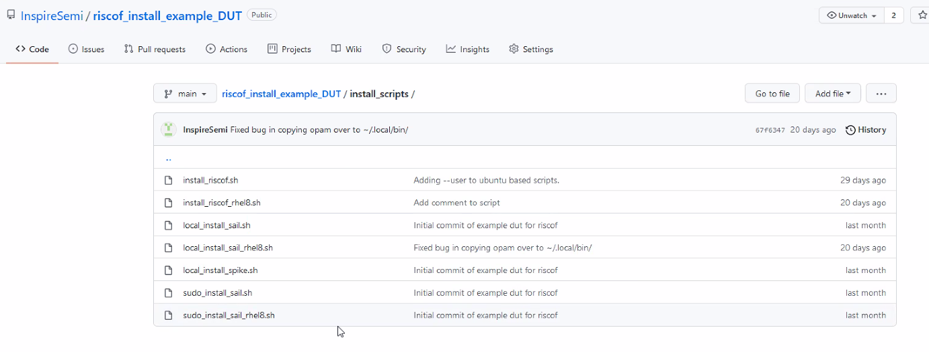
Example riscof repo

Slide 21
Pull/Issue Status
Issue# | Date | submitter | title | status | comments
pull#270 | 13-Jul-22 | UmerShahidengr | Added PMP Compliance Tests | Under review
Pull#268 | 02-jul-22 | Abdulwadoodd | Add a CI script to update the encoding.h file | Will be closed | Require test authors to rebuild encoding.h
pull#267 | 30-jun-22 | bilalsakhawat | Add changes to enable multiple Privilege Modes in Trap Handler | Needs Review,update | Split into arch_test.h, test_case.h
#266 | 30-jun-22 | DTowersM | RVTEST_CASE d_fsd-align and d_fld-align regex typo | Fixed with new tests | But new tests haven’t been merged yet
#263 | 29-Jun-22 | Abdulwadoodd | Complete PMPCFG abd PMPADDR CSRs are not supported for 64 PMP entries | Will be fixed | By rebuilding encoding.h
#262 | 15-Jun-22 | Miogul | Possible bug in privilege/misaligned load tests | In progress | Submit PR after testing new trap handler
#261 | 12-Jun-22 | KinsaQamar | RISC-V COMPLIANCE on SweRV EL2 | discuss
Pull#260 | 02-Jun-22 | UmerShahideng | Added new PMP verification tests | Under review
Pull#252 | 20-apr-22 | kuopinghsu | fix error on BSD diff | In progress | Did’t pass CI
#259 | 01-jun-22 | marcfedorow | No makefrags | N/A | Makefrags no longer used, remove all
#256 | 09-may-22 | Zhongxixuzhi | some float/double cases are not right | Low priority | Coments wrong, tests are correct
#258 | 18-may-22 | misterjdrg | FPU: missing test for FS bits of Mstatus | High priority | Being fixed
#250 | 17-apr-22 | misterjdrg | Possible bugs in D test macros | High priority | Fixes in progress
#249 | 07-ap-22 | Duncaningram | RISC-V Toolchain | Under investigation | Maybe need to change march string?
pull#245 | 29-Mar-22 | anku-anand | Crypto Scalar updates | Needs review | Merge conflict
pull#243 | 15-Mar-22 | yungchinghsiao | Test cases for P extension | Needs review | Merge conflict
pull#238 | 10-Mar-22 | ptprasanna | RV64F Extension's all instructions | Needs review
pull#237 | 28-Feb-22 | hemanthkumar17 | Zfh extension support | Awaiting changes | Need fixes
#233 | 23-Feb-22 | pawks | Update isa for privilege tests |  | Should be a simple fix to rvtest.h macro def
pull#228 | 24-jan-22 | anku-anand | Bitmanip | Needs review | Fixed?
pull#226 | 17-dec-21 | liweiwei90 | add support for cbo.zero in cmo extension | Can be merged
#211 | 19-sep-21 | Neelgala | default rvtest_data should be 16-bytes
#203 | 24-Aug-21 | Allenjbaum | Fence test has poor coverage |  | Specifically: test fm bits are ignored
#190 | 26-Apr-21 | neelgala | The 16-byte signature boundary issue
#119 | 17-jun-20 | allenjbaum | Missing RV32i/RV64i test: Fence | Test has been written | Close when RFQ test is merged
pull#129 | 31-jul-20 | nmeum | sail-riscv-ocaml: Disable RVC extension on all devices not using it | Fixed in riscof?
#189 | 26-Apr-21 | neelgala | Proposal to enhance the RVTEST_ISA macro | ^
#146-9 | 01-Dec-20 | Imperas | Test I EBREAK,ECALL, MISALIGN_JMP/LDST, OpenHW | | | HW misalign support not configurable
#40 | 4-Feb-19 | debs-sifive | Usage of tohost/fromhost should be removed | | | Now
#22 | 24-Nov-18 | brouhaha | I-MISALIGN_LDST-01 assumes misaligned data access will trap | v | HW misalign support not configurable
#4 | 03-Jul-2018 | Kasanovic | Section 2.3 Target Environment | Fixed in riscof | Will be closed in V3

Slide 22
JIRA Status
Issue# | Date | submitter | title | status | comments
CSC-1 | 20/Aug/20 | Ken Dockser | Come up with names for the tests suites that we are creating |  | 1st step done
CSC-2 | 20/Aug/20 | Ken Dockser | Produce concise text to explain the Architecture Tests intent and Limits | done | Will become ACT policy
CSC-3 | 20/Aug/20 | Ken Dockser | Come up with an internal goal for what we wish to accomplish with the Architectural Tests |  | This is the /test coverpoint YAML
CSC-4 | 20/Aug/20 | Ken Dockser | Develop a roadmap for all the different categories of test suites that will need to be created |  | Not written
CSC-5 | 20/Aug/20 | Ken Dockser | Develop a roadmap for releases of single-instruction Architecture Tests |  | Not written
CSC-6 | 20/Aug/20 | Ken Dockser | Develop a reference RTL test fixture that can stimulate and check the CPU under test |  | Needs more discussion

Slide 23
Non-determinism in Architectural Tests
The RV architecture defines optional and model/µarch defined behavior. This implication: there are tests that have multiple correct answers. E.g.:
Misaligned accesses: can be handled in HW, by "invisible" traps w/ either misaligned or illegal access causes, and do it differently for the same op accessing the same address at different times (e.g. if the 2nd half was in the TLB or not)
Unordered Vector Reduce ops: (different results depending on ordering & cancellation)
Tests involving concurrency will have different results depending on microarchitectural state, speculation, or timing between concurrent threads (e.g. modifying page table entry without fencing)
From the point of view of ACTs, there are 2 (& sometimes more) legal answers. The golden model only generates one. Possible mechanisms to test include:
Modify (if necessary) & configure reference model to generate each legal result, run it with each config, & accept either result from the DUT (e.g. misalign or un-fenced PTE modification)
Provide specific handlers for optional traps? (can’t test the trap is correct then)
Use self-testing tests(compare with list or range of allowed outcomes from litmus tests)
Avoid tests that can generate non-deterministic results
Ultimately: develop new frameworks that can handle concurrency along with reference models that can generate all legal outcomes
It is the responsibility of the TG that develops an extension to develop the strategy for testing features and extensions that can have nondeterministic results

Slide 24
Framework Requirements
The framework must:
Use the TestFormat spec and macros described therein
(which must work - including assertions)
Choose test cases according to equations that reference the YAML configuration
Define macro variables to be used inside tests based on the YAML configuration
Include the compliance trap handler(s), & handle its (separate) signature area(s)
Load, initialize, and run selected tests between two selected models, extract the signatures, compare results, and write out a report file
Exist in a riscv github repo, with a more than one maintainer.
Be easy to get running, e.g.:
run under a variety of OSes with the minimum number of distro specific tools.
Not require sudo privileges
Have the ability to measure and report coverage for test generation
Coverage specification is a separate file
Could be a separate app

Slide 25
Test Acceptance Criteria
Tests merged into the ACT test_suite repo must :
conform to the current format spec (macros, labels, directory structure)
including framework-readable configurations - i.e. which ISA extension it will be tested with (using Test_Case macro parameter equations) for each test case
use only files that are part of the defined support files in the repository, including standard trap handlers
TBD: how to install test specific (not model specific) handlers
Be able to be loaded, initialized, run, signal completion, and have signature results extracted from memory by a/the framework
run using the SAIL model and not fail any tests
generate signature values either
directly from an instruction result (that can be saved & compared with DUT/sim)
by comparing an instruction result with a configuration-independent value range embedded in the test code (e.g. saving above, below, within)
by comparing an instruction result with a configuration-independent list of values (e.g saving matches or mismatched)
(it can be useful to also return a histogram of value indices that matched)
Store each signature value into a unique memory location in a signature region that is
delimited by standard macros embedded in the test which can be communicated to the test framework
pre-initialized to values that are guaranteed not to be produced by a test
have defined coverage goals in a machine readable form that can be mechanically verified
improve coverage (compared to existing tests) as measured and reported by a coverage tool (e.g. ISAC)
use only standard instructions (and fixed size per architecture macros, e.g. LI, LA are allowed)
be commented in test_case header (ideally listing coverpoint covered)
Tests that are otherwise accepted, but depend on tools or simulators that have not be upstreamed must be put into a <Ext-Name_unratified>/ directory instead of <Ext-Name>/

